Slide 1

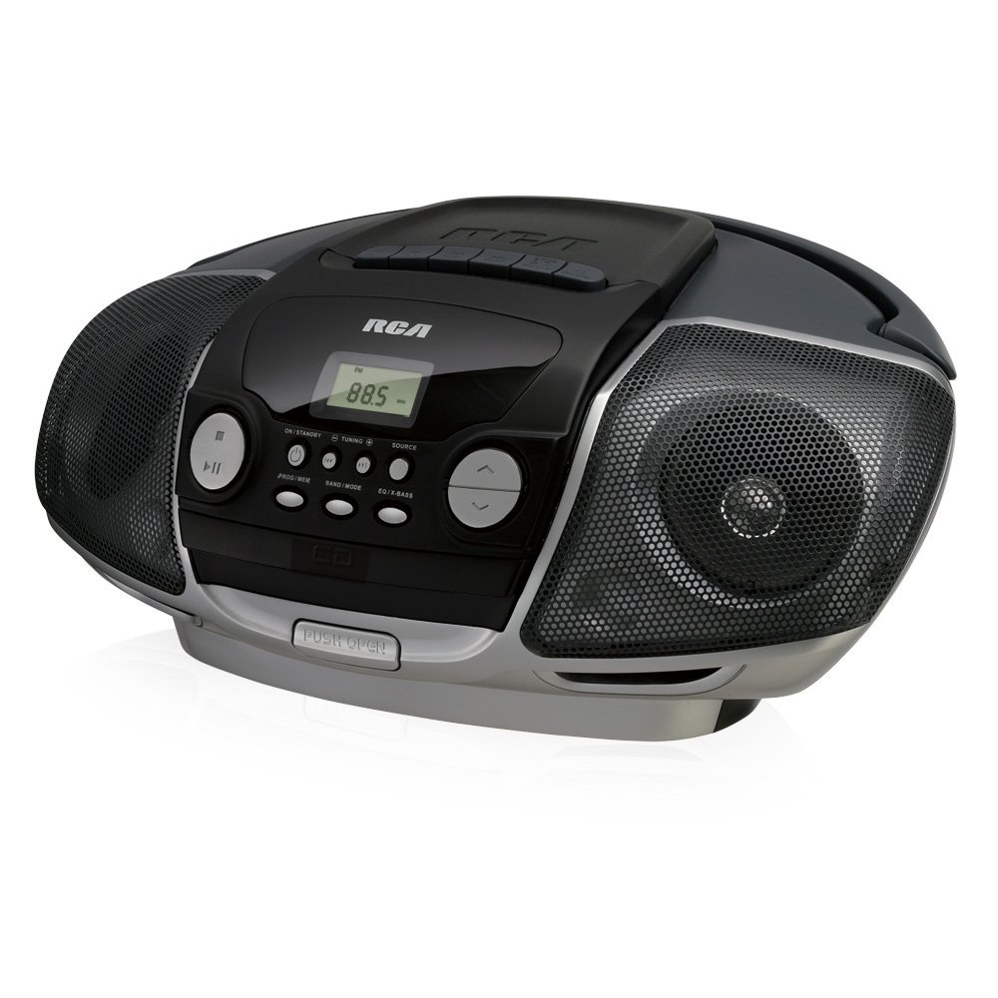

RCD175
BOOM
BOX
Portable CD Player with cassette and radio
RCA
Digital AM/FM tuner with 20 presets
Front-Load CD player
Cassette player & recorder
Dynamic bass boost
Audio line-in jack

